Slide 1


FACE RECOGNIZATION

Slide 2

01
INTRODUCTION
03
CONCLUSION
02
WORK DIVISION
04
REFERENCES

Slide 3
INTRODUCTION
About the Project?
Module-1.1
Module-1.2
What it can Do?
Software Requirements
Module-1.3
Module-1.4
Real Life Examples

Slide 4

ABOUT THE PROJECT
A real time face recognition system can identify or verifying a person from a video frame. To recognize the face in a frame, first you need to detect whether the face is present in the frame.

Slide 5
WHAT IT CAN DO
AGE
It detects the age of the person who was in frame
FACE DETECT
It detects the face whether it is present in the frame or not
GENDER
It detects the Gender of the person who was in frame

Slide 6

How actually this works
There are two types of models in this 1.Live Feed
2.Image Feed

Slide 7
HOW IT WORKS
Live Feed
Now it divides the live capture into the images based on frames/sec
Once it detected it will analyse the age and gender
STEP 2
STEP 4
STEP 1
STEP 3
STEP 5
First it looks for the face whether it is present in the frame or not
Now it analyses the images and gives us output based on trained images as we said in previous model
Finally we will get the output in the type of square on face with age and gender

Slide 8
HOW IT WORKS
Image Feed
Look for the face in image
Once it detected it will analyse the age and gender
STEP 2
STEP 4
STEP 1
STEP 3
STEP 5
First it looks for the face whether it is present in the Picture for not
Now it analyses the image and gives us output based on trained images as we said in previous model
Finally we will get the output in the type of square on face with age and gender

Slide 9
SOFTWARE REQUIREMENTS &LIBRARIES INCLUDED
OPEN CV
ARGPARSE
MATH
OpenCV is short for OpenSource Computer Vision. Intuitively by the name, it is an open-source Computer Vision and Machine Learning Library
Argparse is a complete argument processing library. Arguments can trigger different actions, specified by the action argument to add_argument().
MATH is a inbuilt library in python. This module provides access to the mathematical functions defined by the C standard.
Python- 3.7 and Above

Slide 10
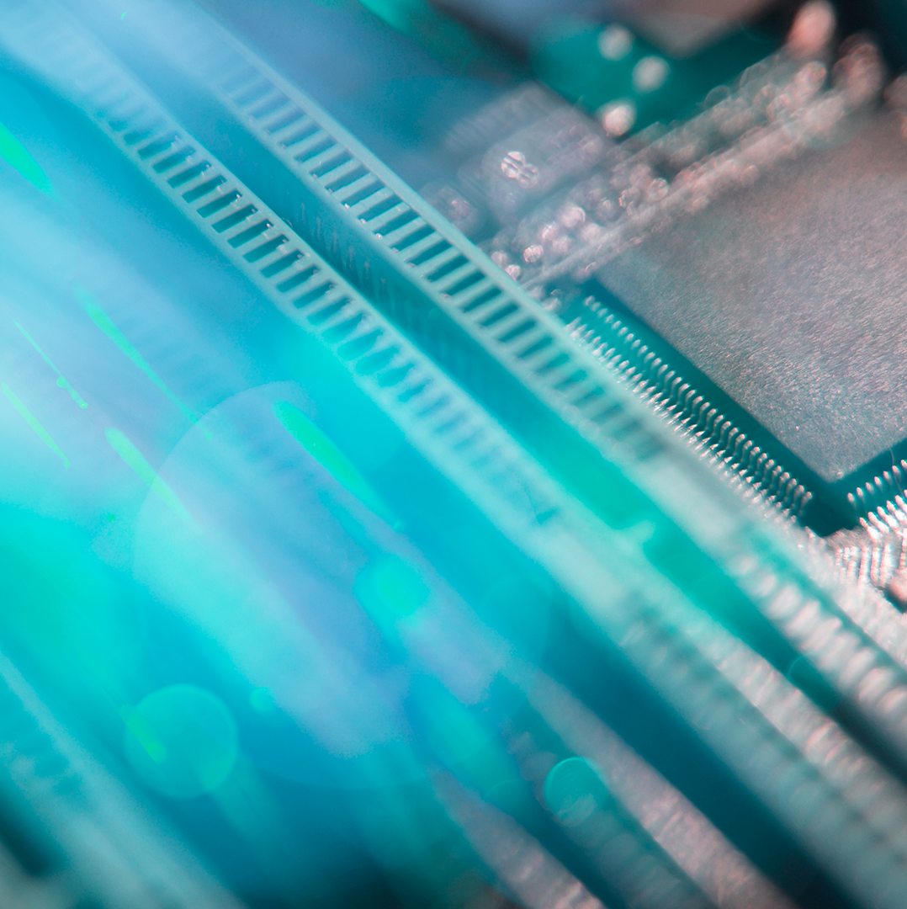
A PICTURE ALWAYS REINFORCES THE CONCEPT

Slide 11
Real Life Usage

Slide 12
Some companies who uses face recogniztion
Lenskart - https://www.lenskart.com/
Trueface - https://www.trueface.ai/
Face Plus - https://www.faceplusplus.com/
Any Vision - https://www.anyvision.co/
Modi Face - https://modiface.com/
Deep Vision - https://www.deepvisionai.com/
Deidentification - https://www.deidentification.co/

Slide 13


ANY Questions?

Slide 14
THANK YOU ALL!

